Slide 1
Mind the Gap
Stephen Thomas
22/6/17

Slide 2
‘Mind the Gap’
Measuring the gap between Customer Expectations and Satisfaction for people with a disability
What we will cover
Method for measuring Consumer Satisfaction
Survey tool for measuring Consumer Satisfaction within Disability Services
Consumer participation in developing the tool and in completing the survey
Method of Presenting the results

Slide 3
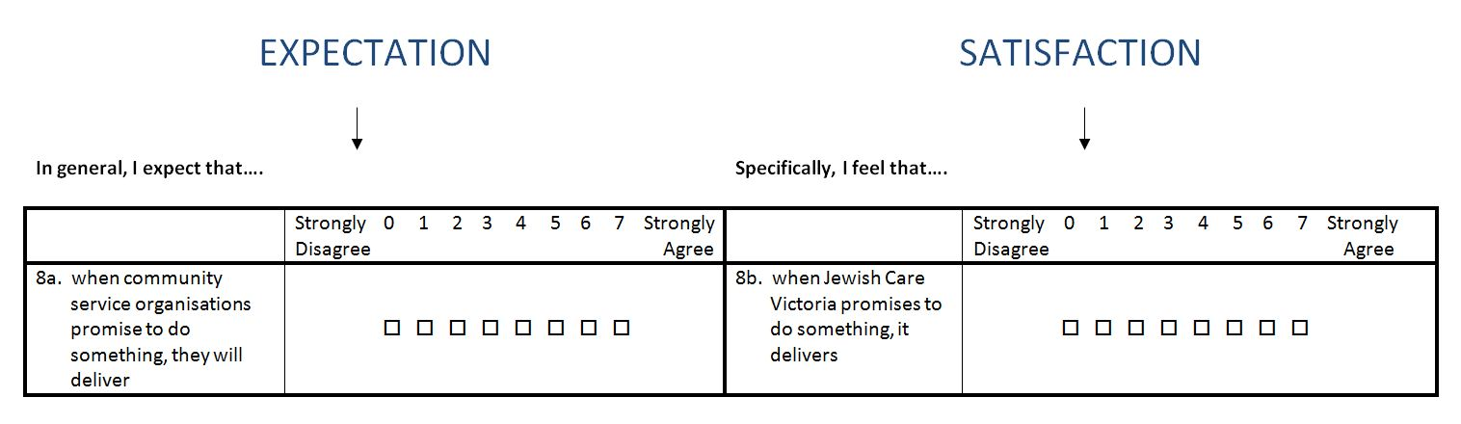
Measuring the gap between customer expectation and satisfaction of people with a disability
Survey Development
SERVQUAL methodology (Parasuraman, Zeithaml and Berry, 1988)1988
Paired Questions
Satisfaction (S) – Expectation (E) = GAP
Enables calculation of Average Expectation Score, Average Satisfaction Score, Average GAP Score (extent to which we have met Expectation)

Slide 4
Question Content
Dimensions and basis for question development
Part | Dimension | Basis for Questions
A: Demographic | Demographics | Categories consistent with recent Jewish Care research Eg: Community Expectations of Jewishness in service delivery
B: Customer Service | Reliability | SERVQUAL
 | Responsiveness | SERVQUAL
 | Assurance | SERVQUAL
 | Empathy | SERVQUAL
C: Service Delivery | Empowerment | DHS Standards
 | Access and Engagement | DHS Standards
 | Wellbeing | DHS Standards
 | Participation | DHS Standards

Slide 5
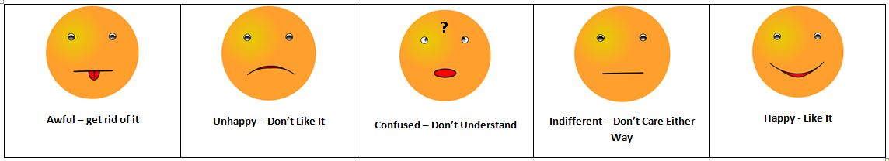
Development of the survey
Customer Consultation
Promoting Participation and Social Inclusion
Innovative consultation methodology
Diverse group of Residents/clients/carers invited to attend focus group.
Provided list of numbered questions and set of numbered stickers.
Voted to indicate how they felt by placing sticker with question number on the poster that best described how they felt.
Votes tallied and discussion invited on questions for which at least half of consumers voted ‘Awful’, ‘Unhappy’ or ‘Confused’. Changes made to questions.
Consumer Feedback
Did the focus group activity help you to provide feedback about the Jewish Care Customer Satisfaction Survey? 100% YES
Was the focus group run in a way that made you feel included? 100% YES

Slide 6
Consumer Participation
Promoting the Customer Voice
Survey Versions
ONLINE
Client English
Client Russian
Carer English
Carer Russian
PAPER BASED (postal)
Client English
Client Russian
Carer English
Carer Russian
Next version we are planning to develop an Easy Read Version

Slide 7
Example of Questions

Slide 9
Interpreting the Scores – The EXSAT GRID ©
Warning CI Plan required. Expectation too high or unsatisfactory Service
Ideal Result
Acceptable Result but CI required
Acceptable Result but CI required
Not Acceptable CI Required
Warning CI Required Expectations to low

Slide 10
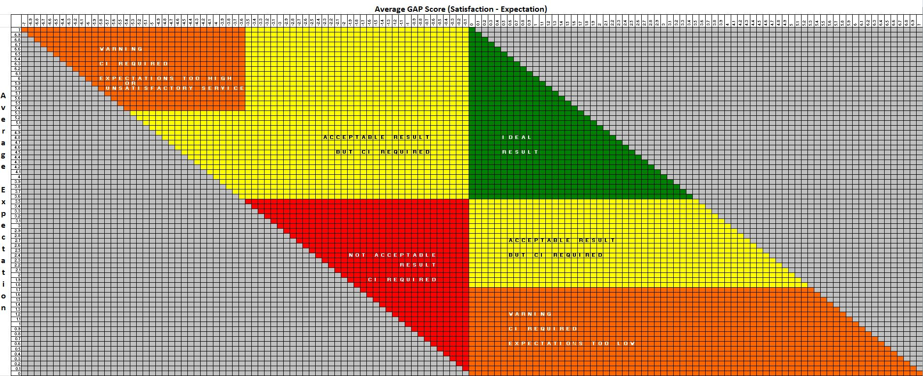
The EXSAT Grid ©
The intersection between coordinates determines the Result
In this example:
Average E = 5
Average S = 6.2
Average GAP= 1.2

Slide 11
The EXSAT Grid ©
The intersection between coordinates determines the Result
In this example:
Average E = 1.5
Average S = 2.7
Average GAP = 1.2

Slide 12
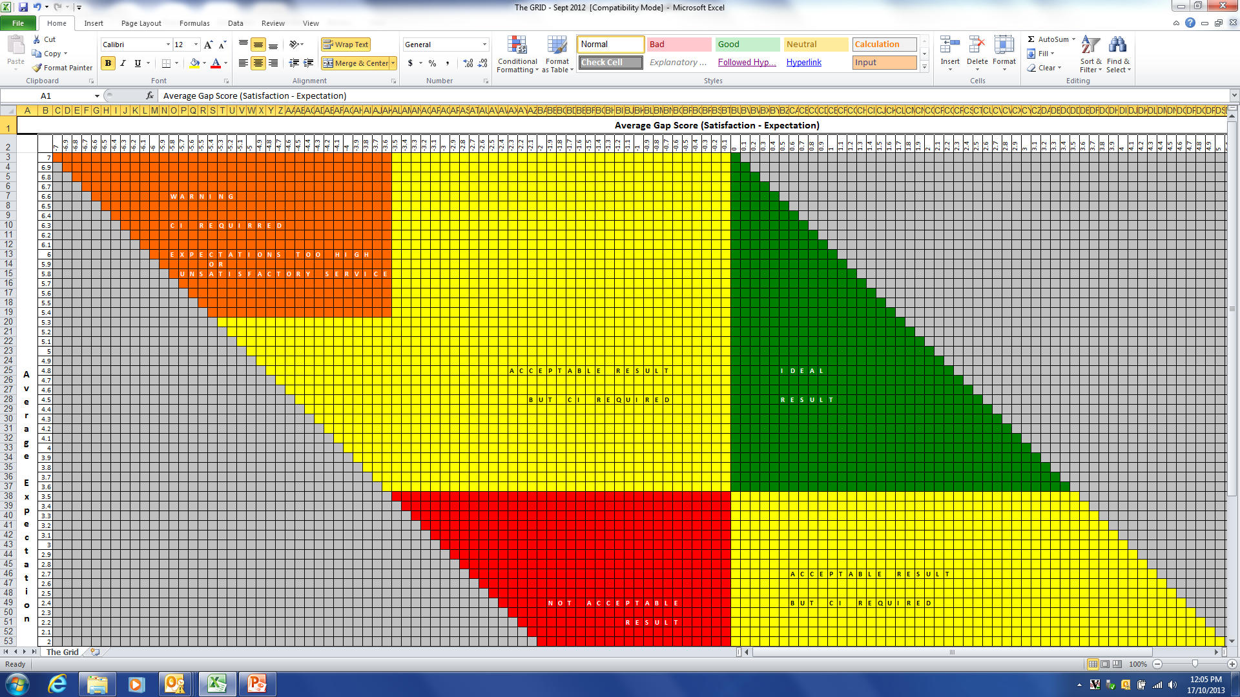
Part B – Customer Service (2013)
RELIABILITY
ASSURANCE
EMPATHY
RESPONSIVENESS

Slide 13
Part C –Service Delivery (2013)
ACCESS
EMPOWERMENT
WELLBEING
PARTICIPATION

Slide 14
What have we done since 2013
Disability Services
Set up regular management groups who meet regularly to plan and coordinate service delivery. This has assisted in ensuring Disability Services are able to:
  implement the Five Year Disability Plan
  provide a forum for peer support and client / case review,
  implementation new quality initiatives
Continued relationship with La Trobe University in 2014 to embed Person Centred Active Support (PCAS) across our programs.
Implemented several processes to better track work and activities required for both compliance and improved service delivery.
Implemented Senior Project Officer role in Disability Services to drive CI and quality processes with a focus on Person Centred Plans and staff annual training.
Regular Quality Meeting established and supported by the RQIP Unit and Quality Compliance Manager
Improved Complaints Handling practices implemented
Regular stakeholder meetings set up across all programs
Email distribution lists set up across programs to easily disseminate information and updates

Slide 15
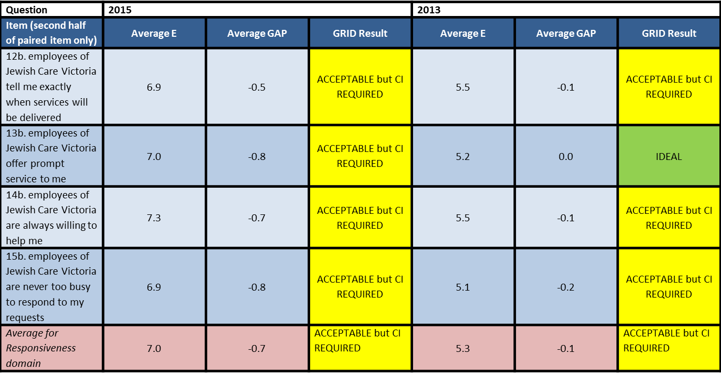
Continuous Improvement over time
Part B – Customer Service (B2 – Responsiveness)

Slide 16
Customer Service – Reliability

Slide 17
Customer Service – Responsiveness

Slide 18
Customer Service – Assurance

Slide 19
Customer Service – Empathy

Slide 20
Service Delivery - Empowerment

Slide 21
Service Delivery - Access

Slide 22
Service Delivery - Participation

Slide 23
Service Delivery - Wellbeing

Slide 24
Net Promoter Score
Promoters (score 6-7) are loyal enthusiasts who will keep buying and refer others, fuelling growth
Passives (score 5-6) are satisfied but unenthusiastic customers who are vulnerable to competitive offerings.
Detractors (score 0-4) are unhappy customers who can damage your brand and impede growth through negative word-of-mouth.
The formulae is % Promoters - % Detractors

Slide 25
Research into Action
Implications and actions for practice
EXSAT GRID enables service providers to:
  determine the extent to which consumer expectations have been met; allowing simple diagnosis of areas for continuous improvement and considered management of consumer expectations.
  track improvement over time.
  benchmark against other service providers who are measuring performance on the same Dimensions.
  design surveys to measure performance on any given Dimension.
  The Survey Tool for Disability Services enables service providers to:
  gather evidence to inform how well they are performing against industry Standards, with the view to moving from meeting consumer expectations to exceeding consumer expectations.
  offer their consumers the opportunity to provide feedback using a tool developed in collaboration with consumers.

Slide 26
sthomas@jewishcare.org.au

