Slide 1


NDIS Update
EDSN Forum 2 – 22 June 2017
Brian Kirk
Learning & Development
NDS VIC
Notes:
Acknowledgement

Slide 2
Getting the NDIS on track
Document released nationally by NDIS in early May 2017
Proposes practical measures to reduce avoidable pressures/risks on the NDIS
Reflects member feedback
Positive reception from members and the community to date

Slide 3
Getting the NDIS back on track
Trial planning partnerships with specialist disability service providers
Commence plan development with an accurate description of current supports
Allow participants the opportunity to comment on their plan before it is finalised
Include coordination of supports in the plans of participants with complex conditions
Inform current providers of a participant as soon as they have an approved plan
Less questions in the assessment/planning process
‘Work first’ approach re employment supports in plans
Access to SLES as early as Year 10; extend SLES beyond 2 years for employment outcomes
Suite of initiatives to ensure viability of SEEs
Emergency response system with 24 hour phone line
Compensation for increased costs to providers in case of natural disasters
Notes:
Trial planning partnerships with specialist disability service providers, utilising their expertise and knowledge of their clients whilst managing potential conflict of interest
Commence plan development with an accurate description of current supports, sourced from the participant and his or her current providers
Allow participants the opportunity to comment on their plan before it is finalised
Include coordination of supports in the plans of participants with complex conditions
With consent, inform the current providers of a participant as soon as she or he has an approved plan
Reduce the high number of questions asked of participants during the assessment and planning process
Adopt a ‘work first’ approach in planning to increase the proportion of plans with employment supports
Commence access to School Leaver Employment Supports (SLES) as early as Year 10 and extend SLES beyond two years if a participant’s employment is the probable outcome
Secure a viable future for jobs in Supported Employment Enterprises by resolving funding and wage assessment issues and promote the procurement of goods and services produced by people with disability
Establish an emergency response system by extending the NDIS 1800 phone line to 24 hours a day and forming response panels of disability support providers in all regions
Compensate providers when they incur a sudden escalation of support costs in responding to a natural disaster

Slide 4

Getting the NDIS back on track
Streamline provider registration across states
Don’t compel future separation of SDA & SILs beyond separate service agreements
Fund user cost of capital for respite houses and day services
Discontinue in-kind arrangements
Pending price de-regulation, measures to ensure realistic prices
Revise method for determining remote locations and price loadings
Establish industry advisory group to design and test ICT system changes before their introduction
Use co-design to work out how participants with complex needs or who live in regional or remote areas can best be assisted to travel
Cease requirement that providers must quote for all SILS participants
Establish dedicated telephone service
Fund and assist development of industry plan, led by the NG sector
Expand provision of market data
Establish national disability research entity
Notes:
Subject to certain conditions, streamline registration by provisionally approving disability service providers that meet quality requirements in one jurisdiction to operate in other jurisdictions and/or deliver new supports
Do not compel the future separation of Specialist Disability Accommodation and Supported Independent Living beyond separate service agreements (and the requirement that providers have sound processes for resolving conflicts)
Fund the user cost of capital for respite houses and day centres
Discontinue in-kind arrangements that limit participant choice and contradict the principle of competitive neutrality
Pending the deregulation of NDIS prices:
set individual participant budgets based on reasonable and necessary supports, realistic costs (derived from real data) and evidence-based reference packages;
allow participants (their representatives) and providers to negotiate prices for supports without exceeding the participant’s budget;
publish a price guide based on market information to enable participants (and their representatives) to compare and negotiate prices;
base purchasing on hours or on deliverables
Revise the method for determining remote locations and price loadings to reflect the full cost impact of local conditions
Establish an industry advisory group to design and test ICT system changes before they are introduced
Use co-design to work out how participants with complex needs or who live in regional or remote areas can best be assisted to travel
Cease the requirement that providers must quote for all Supported Independent Living participants, not just for those whose support exceeds the benchmark price and work with the sector to improve the Supported Independent Living template
Establish a dedicated and responsive telephone service for providers and a state-wide point of contact familiar with issues in that jurisdiction who has the authority to resolve them
Fund and assist the development of an industry plan, led by the non-government sector
Expand the provision of market data to assist providers with their planning and investment decisions
Establish a national disability research entity, structured similar to the Australian Housing and Urban Research Institute

Slide 5
NDIS 3rd Quarterly Report 2016-17

Slide 6
NDIS 3rd Quarterly Report 2016-17
Notes:
NB This report was released in early May and is segmented by state, amongst other things
-75K participants had received an approved plan as of 31st March, of these 14K in the quarter
2,439 children had been referred through the ECEI gateway
88% of surveyed participants rated the experience as either good or very good
87% of surveyed participants said they believed their NDIS plan would make their life better
6814 service providers have been registered (only about 33% are providing services at present

Slide 7
PC’s Review of NDIS Costs
Notes:
A reminder …

Slide 8
PC’s position paper on NDIS Costs
Reinforces many issues raised by NDS
Range of recommendations re improving planning quality
Current policy setting unlikely to see enough providers and workers as scheme rolls out.
Immediately introduce Independent Price Monitor to review prices
Relax guidelines re paying informal carers living with participant
Implementation of e-market and more detailed market position statements
Increased funding for ILC
NDS keen to get member feedback re position paper: Ken Baker/Philippa Angley
Notes:
The Productivity Commission's position paper on NDIS Costs reinforces many issues raised in NDS's recent 'How to get the NDIS on track' paper. It says the NDIA should "find a better balance between participant intake, the quality of plans, participant outcomes and financial sustainability," and seeks further input on how this might be achieved.
To improve the quality of planning, the Commission recommends:
allowing minor amendments to plans without triggering a full plan review;
refining protocols on phone planning;
improving information available to potential participants;
ensuring Local Area Coordinators are in place six months before the scheme is rolled out in an area;
developing better knowledge of disability among planners; and,
having specialised planners available or to make more use of industry knowledge.
Given the extent of the problems with planning, the Commission also recommends the NDIA be required to report regularly on the quality of plans.
NDIS prices and the method of setting them is a focus of the report, not least because "present policy settings are unlikely to see enough providers and workers as the scheme rolls out."
The paper's main recommendation regarding pricing flags the possibility of a major change in how prices are set and monitored:
Immediately introduce an independent price monitor to review the transitional and efficient maximum prices for scheme supports set by the NDIA
Transfer the NDIA's power to set price caps for scheme supports to an independent price regulator by July 2019
As the NDIA has not adequately listened to the sector on the costs of service delivery, an independent price monitor may be useful. A proviso, however, is that until it is in operation, its assessment of the adequacy of prices is unknown. Despite this uncertainty, NDS is inclined to support the immediate introduction of an independent price monitor, but would like to hear members' thoughts. We also seek feedback on whether members support the establishment of an independent price regulator from July 2019.
In a surprising move, the Commission recommends relaxing guidelines on paying informal carers who live in the same residence. NDS has concerns that this will displace informal care, introduce insurance complexities and may create a household dependence on the income generated (thus reducing incentives to foster greater independence and perhaps to find employment).
The Commission urges the implementation of an e-Market to improve information flows as a matter of priority. It also proposes the publication of more detailed market position statements on an annual basis and funding the ABS to regularly collect detailed information on the disability workforce.
Other recommendations include requiring governments to make public their plans for continuity of support, to increase the focus of governments on the interfaces the NDIS has with mainstream services, and to increase the funding for Information, Linkages and Capacity Building to $131 million for each year of transition, during which time a review should be undertaken.
NDS will be making a submission. Members are urged to provide feedback on the draft recommendations and information requests (summarised in the overview) to Philippa Angley on 03 8341 4302 or philippa.angley@nds.org.au or to Ken Baker on 02 6283 3203 or ken.baker@nds.org.au by 3 July.

Slide 9
NDIA’s Price Review
Notes:
A reminder …

Slide 10
NDIA Price Review: a disappointing outcome with another review to come
NDIS prices for daily activities (including Supported Independent Living) and community participation will increase by 4.5 per cent from July
Represents indexation for national minimum wage case and ERO on labour costs (approx. 80 per cent of costs) and CPI of 2.1 per cent on non-labour costs
All capital-related supports will increase by 2.1 per cent. No increase in prices for therapy services but limited cancellations will apply
Loadings for Remote and Very Remote will be 20 per cent and 25 per cent respectively (up from 18 per cent and 23 per cent)
No changes to how prices for group supports can be charged
Sector’s submissions re RCM ignored
Independent pricing review by McKinsey’s (NDS to make submission)
Notes:
NDIA has announced NDIS prices for the 2017-18 financial year.
Prices again demonstrate NDIA's failure to respond to the inadequacy of some NDIS prices, particularly those based on the prices for one-to-one support.
Cancellation policy will allow providers to charge for up to two cancellations per participant per year when the participant cancels within 24 hours of the scheduled service. NDS is keen to hear from providers about how these two decisions will impact on the delivery of therapy.
Unfortunately, the NDIA has not provided a range of prices for short-term accommodation to account for higher wages of staff on weekends and public holidays.
For the second consecutive year, the NDIA has disregarded information provided through its price reviews.
This year, the sector was invited to provide input on the assumptions underpinning the reasonable cost model, price banding and matrix pricing. The announced prices demonstrate that information provided was ignored. In particular, the assumptions underpinning the reasonable cost model (such as 95 per cent productivity; five days of personal leave a year; and two days of training per year per FTE) have not been adjusted.
The NDIA has, however, commissioned McKinsey & Company to undertake an Independent Pricing Review, commencing immediately and to be completed by the end of 2017. The Terms of Reference state the review will include a focus on:
National versus regional pricing
Complexity
Pricing of short stay accommodation support (including emergency and crisis supports)
Thin and undersupplied markets
Provider efficiencies
Provider returns
Effectiveness of hourly return approach used to set prices
Approach to deregulation
NDS welcomes the review as it has the potential to address many of the sector's concerns and should help to elucidate the real costs of service provision. However, this must not be simply another review. To ensure this, we will request the NDIA to release the final report to the sector as soon as it is completed.

Slide 11
NDS transition support
Notes:
A reminder …

Slide 12

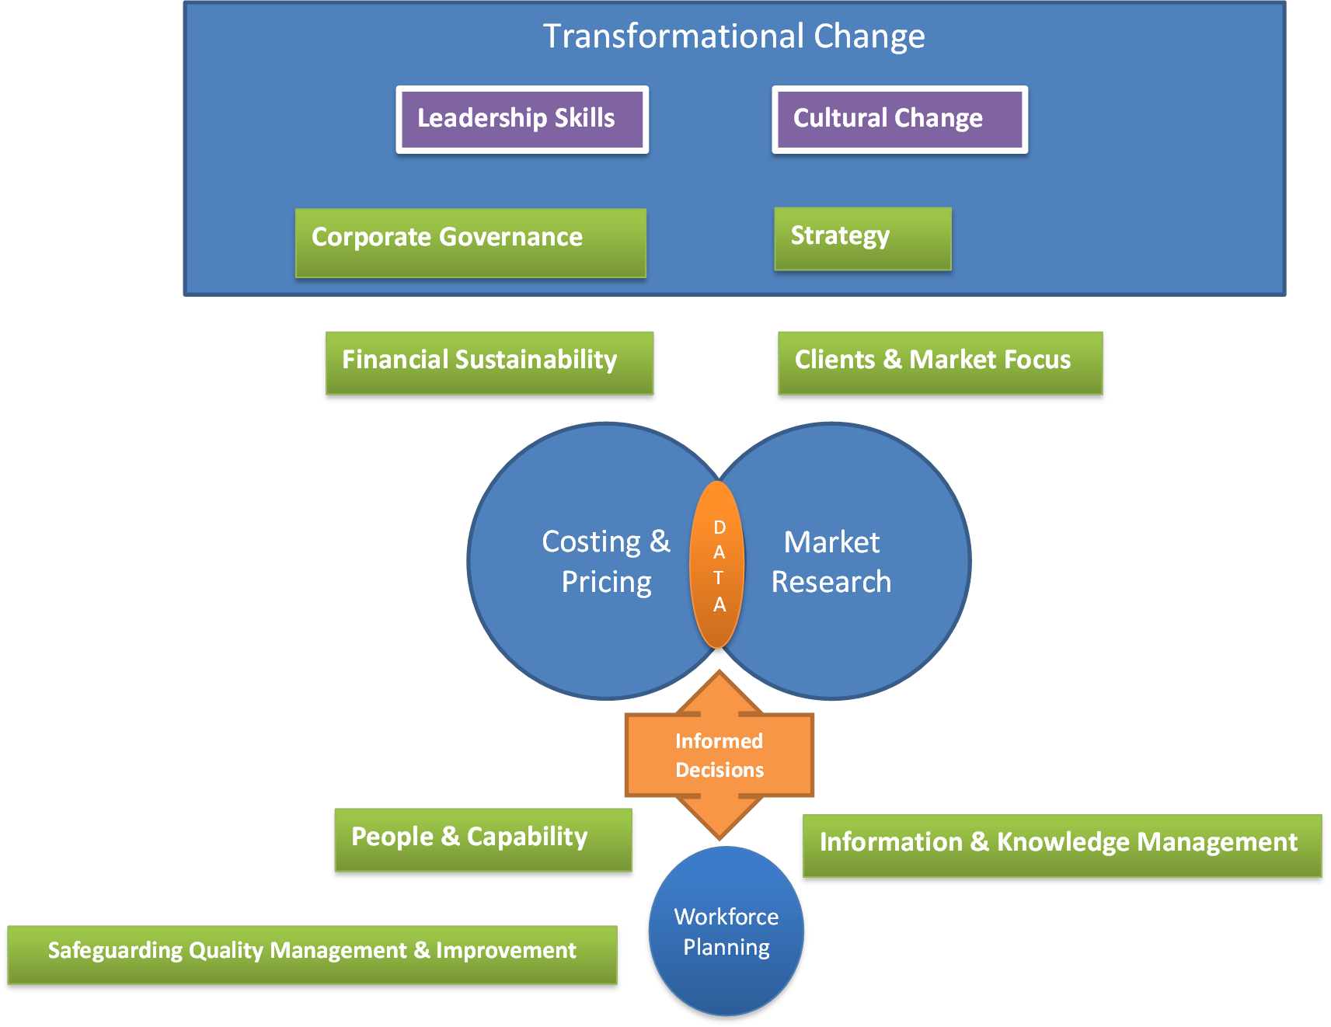

Our Approach:

Slide 13



When can NDS help?

Slide 14
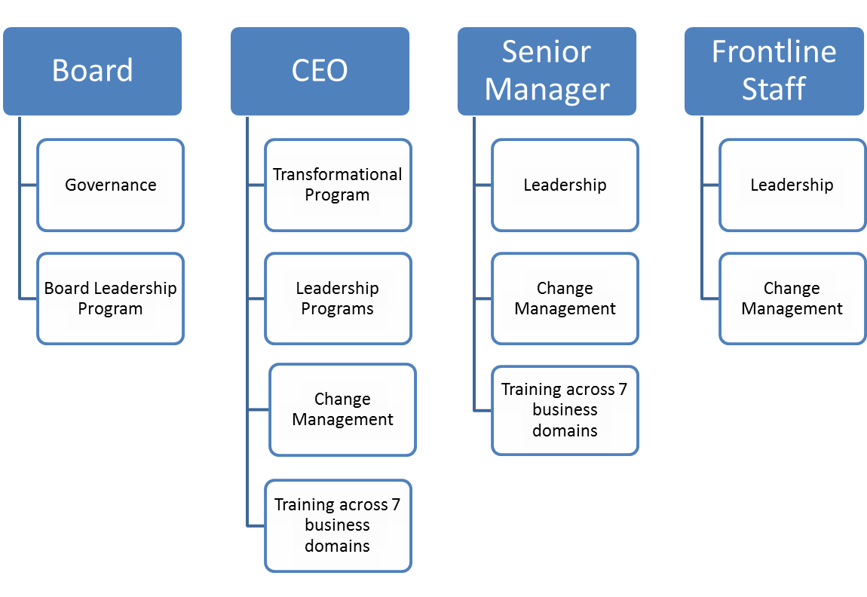

Learning & Development:

Slide 15
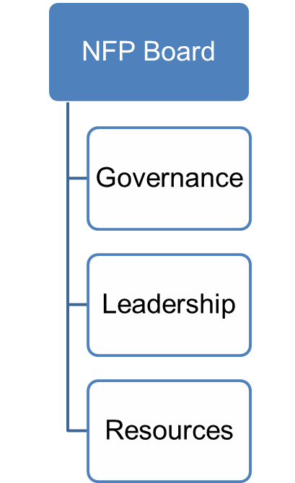
Boards &
CEOS:
Leading for NDIS Transformation
  An 5 day (3+2) residential program building strategic capacity
Zero Tolerance practical guide
  Safeguarding for Boards
Board Leadership
  Leadership Victoria: customised Governance Development Program
Board Mentoring
  Leadership Victoria: 11 month board mentoring program

Slide 16

Resources
Legal Governance Webinar Library
Marketing Governance Webinar Series
Corporate Governance Handbook for Company Directors and Committee members
ACU Board self-assessment
Board Member recruitment Toolkit
NDS NSW – Its your business:
  Chp 1: Corporate Governance (PDF)
  Chp 2: Legal Issues (PDF)
  Chp 6: Risk Management
  Chp 7: Fraud prevention & control (PDF)
  Chp 8: Probity in employment (PDF)
  Chp 9: Partnerships (PDF)

Slide 17

Sector Support Support
Readiness
Readiness and Implementation Series
  Bi-monthly free workshops
  Commencing six months prior to roll out
Professional Communities of Practice
Sector Support Consultancy
Organisational and operational change
Tailored
Available six months prior to roll out

Slide 18



NDS Online Support
NDS Sector Transition Project Page
www.nds.org.au/stpvic
NDIS Helpdesk
www.tinyurl.com/NDISHelpdesk
Free monthly NDIS newsletter
www.nds.org.au/stpvic
NDS Provider Toolkit
www.nds.org.au/resources/ndisprovider-toolkit

Slide 19



Thank you
03 8341 4300
ndsvic@nds.org.au
@ndsvic

